Slide 1
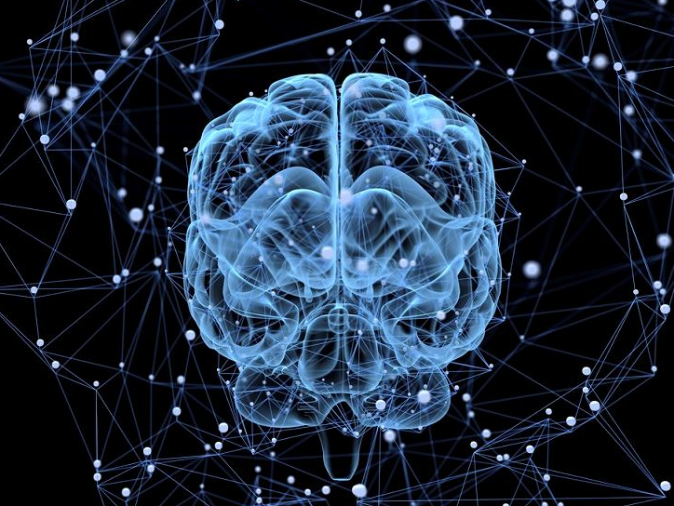
Understanding Human Intelligence: The Neocortex and Memory
(On Intelligence by Jeff Hawkins Chapter 3 & 4)
Meta Kiat-arpadej 2022326660020

Slide 2
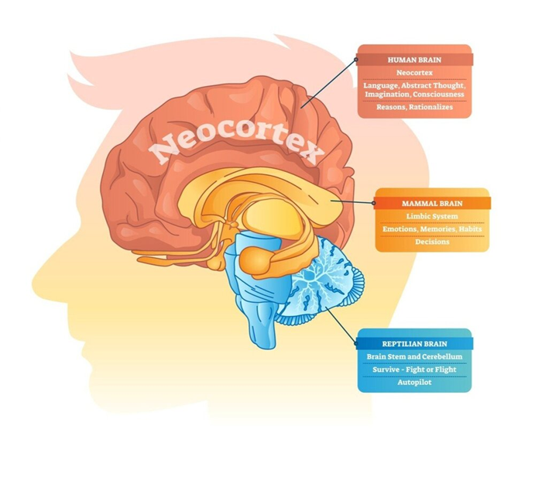

Chapter 3 human Brain
Notes:
Many people thought that neural network is the exact copy of our brain functionality. However, Jeff Hawkins didn’t believe so.

Slide 3
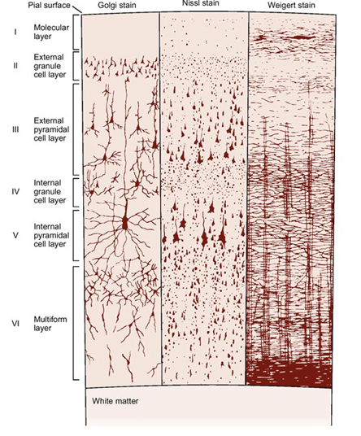

Neocortex
Perception, Conscious, Language, Imagination, Mathematics, Art, Music, and Planning
2 mm thick
6 layers

Slide 4

Neocortex
Notes:
Estimated number of neurons 30 billions and their significance
Emphasize that these neurons contain memories, knowledge, skills, and life experiences.

Slide 5
Neocortex Processing Recognition
Notes:
As information from the senses travels through each layer, each one adds detailed prior knowledge to the raw sensory information.

Slide 6
Patterns in the neocortex
Brains need patterns to memorize an event.
An reoccurrence of something.
Brains are pattern machines, receiving the information through five senses.
Fast and Efficient
Can “UPDATE” the prior knowledge.
Brains know the world through a set of senses → create patterns that send to the neocortex → Process by the same algorithm to create a model of the world.
Brains then hold those patterns in memory to access for future references.

Slide 7
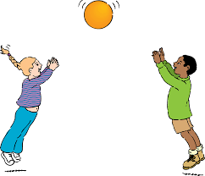
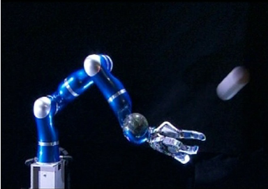
Chapter 4 memory
memory

Slide 8
memory
memory
The brain automatically recalls a memory by the sight of the ball.
The memory recalls the sequence of muscle commands.
The retrieved memory is adjusted as it is recalled to accommodate the details of the moment.
The neocortex stores sequences of patterns.
The neocortex recalls patterns auto-associatively.
The neocortex stores patterns in an invariant form.
The neocortex stores patterns in a hierarchy.

Slide 9
Predicting future events
Brain works by memories from repeated patterns and sequences
Use that memories to predict most likely event to occur in the future.

Slide 10
conclusion
An reoccurrence of an event receiving through the senses is stored in the brain by neocortex layers, where each layer adds detailed prior knowledge to the raw sensory information. The brain then recalls memory stored in neocortex to response or predict to the current or future events.
Jeff Hawkins believes that by understanding how brains work, we can build machines similar capabilities to our brain, unraveling the enigma of human intelligence.
Notes:
Understand and predict make us intelligence

